Slide 1

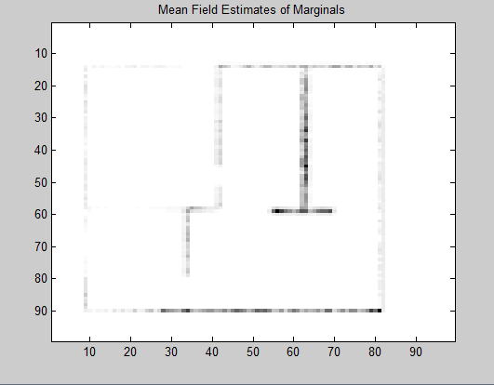
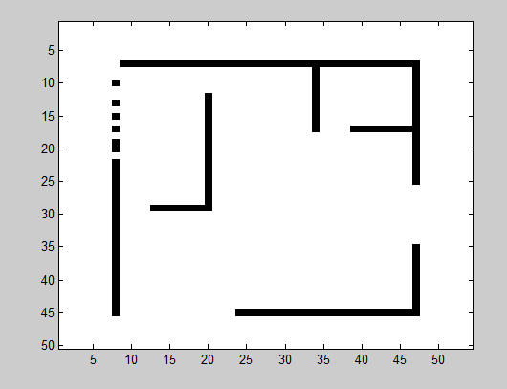
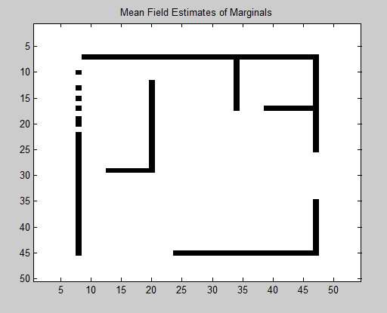
UGM Variational Inference – Mean field
Edge pot = [2.1816 1;1 2.1816]
Edge pot = [2.1816 1;1 2.1816]

Slide 2
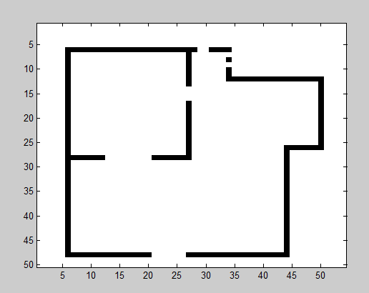
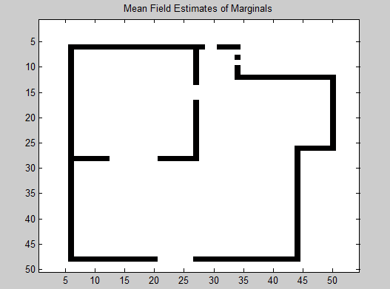
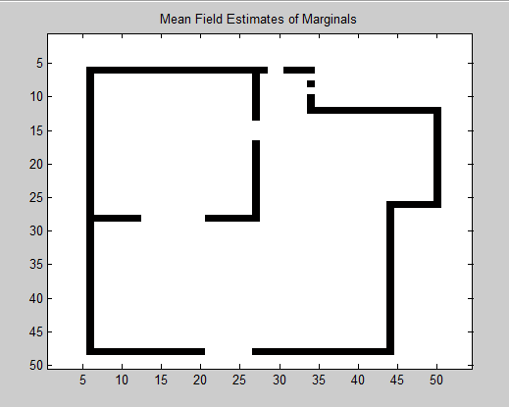
UGM Variational Inference – Mean field
Edge pot = [2.1816 1;1 2.1816]
Edge pot = [3.0676 1;1 3.0676]

Slide 3
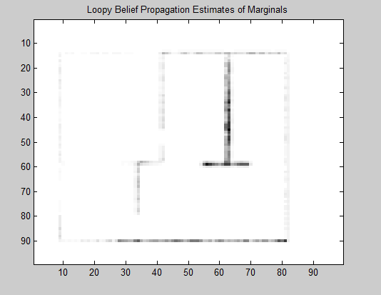
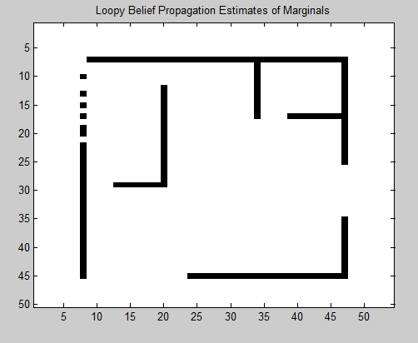
UGM Variational Inference – LBP
Edge pot = [2.1816 1;1 2.1816]
Edge pot = [2.1816 1;1 2.1816]

Slide 4
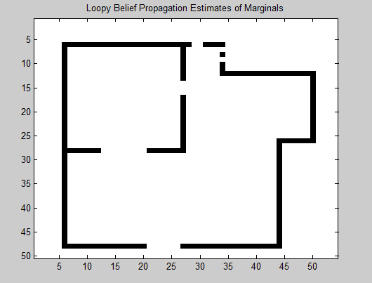
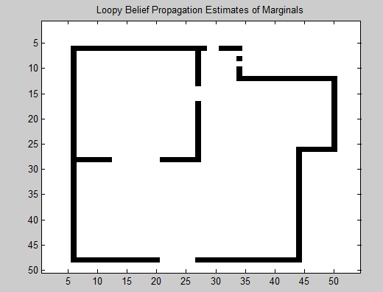
Edge pot = [2.1816 1;1 2.1816]
Edge pot = [3.0676 1;1 3.0676]

